Slide 1
Information Extraction
Jurafsky and Martin Chapter 18
Notes:
Stanford Question Answering Dataset (SQuAD) consists of passages from Wikipedia and associated questions whose answers are spans from the passage, for just over150,000 questions.

Slide 2
Information Extraction (IE)
Information extraction (IE), turns the unstructured text information into structured data
Populate a relational database to enable further processing, support queries
Notes:
Example of building semantic reprentation:
What states border Texas? → ƛx:state(x)^borders(x; texas),
When was Ada Lovelace born? → birth-year (Ada Lovelace, ?x).

Slide 3
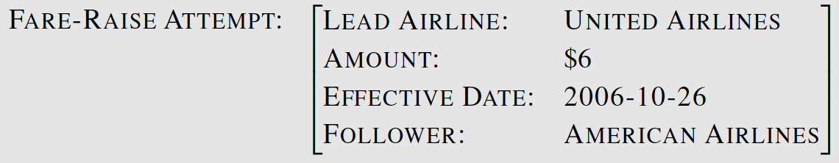
Template Filling
Citing high fuel prices, United Airlines said Friday it has increased fares by $6 per round trip on flights to some cities also served by lowercost carriers. American Airlines, a unit of AMR Corp., immediately matched the move, spokesman TimWagner said. United, a unit of UAL Corp., said the increase took effect Thursday and applies to most routes where it competes against discount carriers, such as Chicago to Dallas and Denver to San Francisco.

Slide 4
Steps in IE
NER and co-reference resolution
relation extraction
spouse-of, child-of, employer-of, partof, membership-in, located-in
event extraction
temporal expression normalization
template filling

Slide 5
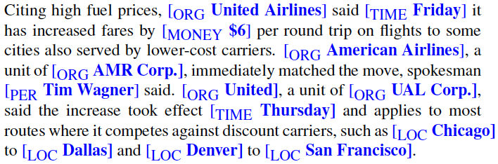
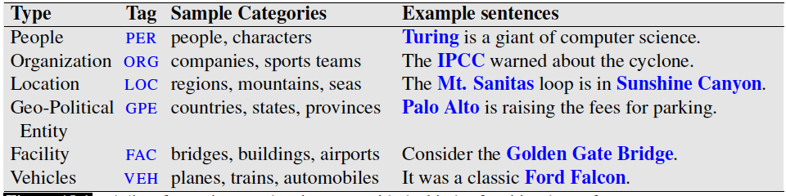
Named Entity Recognition

Slide 6
Named Entity Recognition
Find spans of text that constitute proper names
Ambiguity of segmentation
What’s an entity and what isn’t
Where the boundaries are
Classify the type of the entity
Type ambiguity

Slide 7
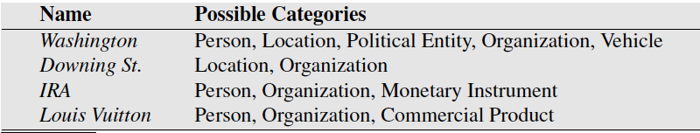
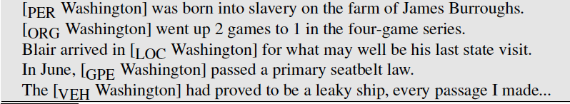
Category Ambiguity in NER
Examples of type ambiguities in the use of the name Washington

Slide 8
NER Algorithms & Evaluations
Word to word sequence labelling
Capture boundary and type
Feature based
Neural
Precision, Recall, F1
Segmentation component can cause problems
Notes:
Segmentation component problem example:
A system that labeled “American” but not “American Airlines” as an organization would cause two errors, a false positive for O and a false negative for I-ORG.

Slide 9
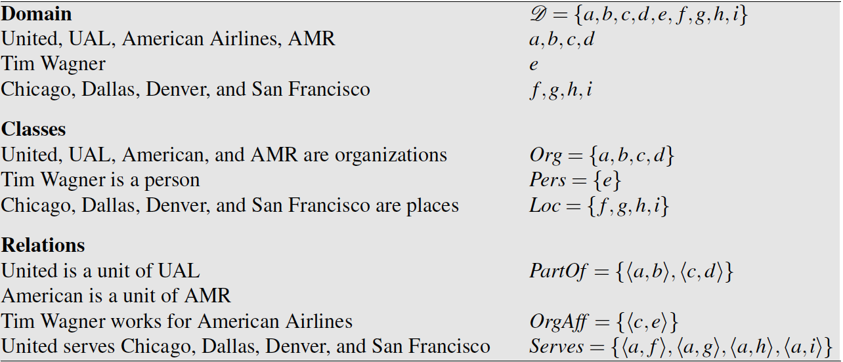
Relation Extraction
A relation consists of a set of ordered tuples over elements of a domain
The domain elements corresponds to the named entities

Slide 10
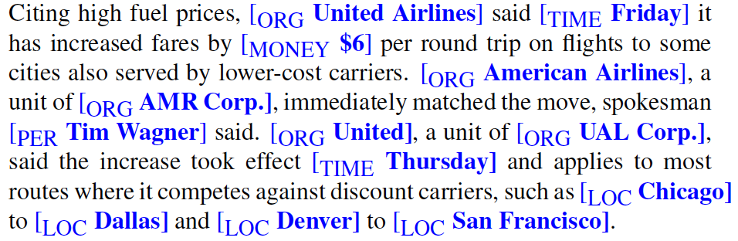
Tim Wagner [is a spokesman] for American Airlines.
United [is a unit of] UAL Corp.
American [is a unit of] AMR.

Slide 11
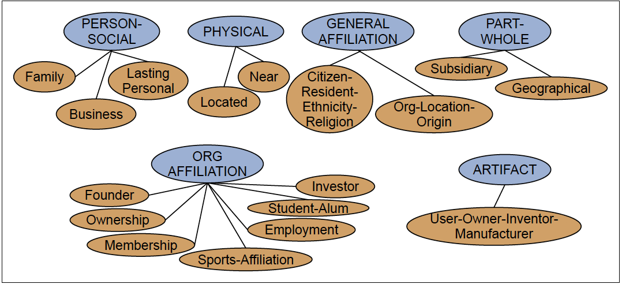
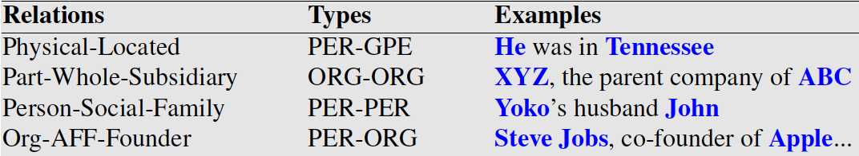

Slide 12
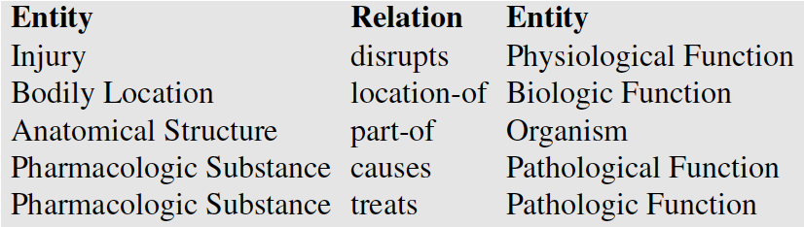
Unified Medical Language System
Given a medical sentence like:
Doppler echocardiography can be used to diagnose left anterior descending artery stenosis in patients with type 2 diabetes
Extract the UMLS relation:
Echocardiography (Doppler) Diagnoses Acquired stenosis

Slide 13
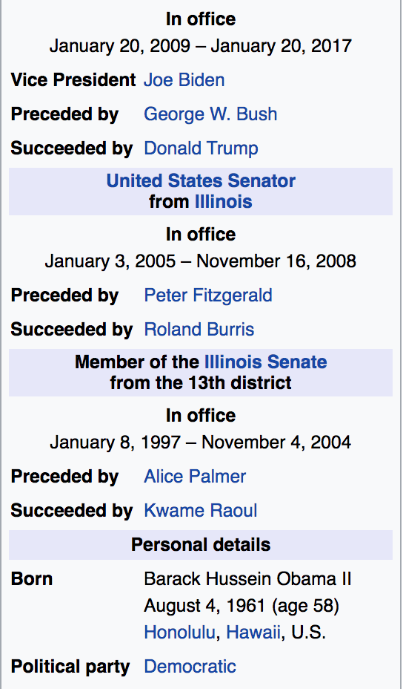
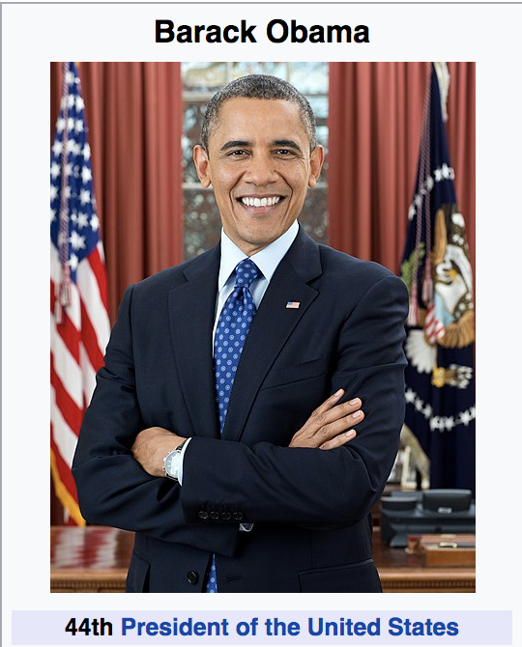
Wikipedia info boxes

Slide 14
RDF Triples
Resource Description Framework
RDF triple is a tuple of
Entity-relation-entity, aka
Subject-predicate-object expression
Subject: University of Pennsylvania
Predicate: location
Object: Philadelphia, PA

Slide 15
DBpedia is a community effort to extract structured information from Wikipedia and to make this information available on the Web. DBpedia allows you to ask sophisticated queries against datasets derived from Wikipedia and to link other datasets on the Web to Wikipedia data. We describe the extraction of the DBpedia datasets, and how the resulting information is published on the Web for human-and machine-consumption. We describe some emerging applications from the DBpedia community and show how website authors can facilitate DBpedia content within their sites. Finally, we present the current status of interlinking DBpedia with other open datasets on the Web and outline how DBpedia could serve as a nucleus for an emerging Web of open data.

Slide 16
Freebase, WordNet, other ontologies
Freebase relations:
people/person/nationality
location/location/contains
people/person/place-of-birth
biology/organism classification
WordNet relations:
is-a, instance-of
hypernyms/hyponyms
Giraffe is-a ruminant is-a ungulate is-a mammal is-a vertebrate is-a animal…

Slide 17
Strategies for relation extraction
hand-written patterns
supervised machine learning
semi-supervised machine learning
Bootstrapping
Distant supervision
unsupervised machine learning

Slide 18
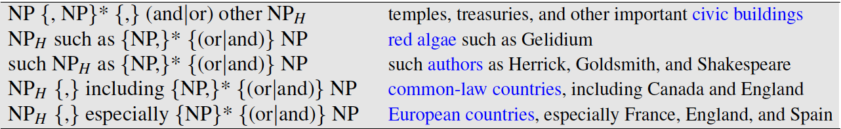
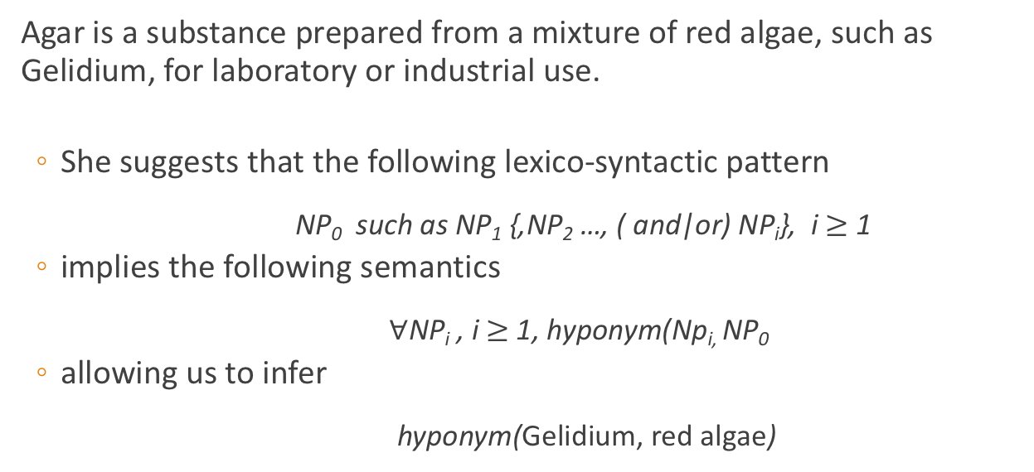
Hearst Patterns
Agar is a substance prepared from a mixture of red algae, such as Gelidium, for laboratory or industrial use.
She suggests that the following lexico-syntactic pattern
NP₀ such as NP₁ {,NP₂ …, ( and|or) NP_{i}}, i $≥$ 1
implies the following semantics
$∀$NP_{i} , i $≥$ 1, hyponym(Np_{i,} NP₀
allowing us to infer
hyponym(Gelidium, red algae)

Slide 19
Machine learning techniques
Supervised: training corpus annotated with manually annotated with fixed set of relations and entities
Semi-supervised: high-precision seed patters, or seed tuples, are used to bootstrap more examples
Distant supervision: start with a huge number of seeds, learn noisy pattern fields (e.g. 100k examples of birth-place-of from infoboxes, help learn the corresponding text patterns)

Slide 20
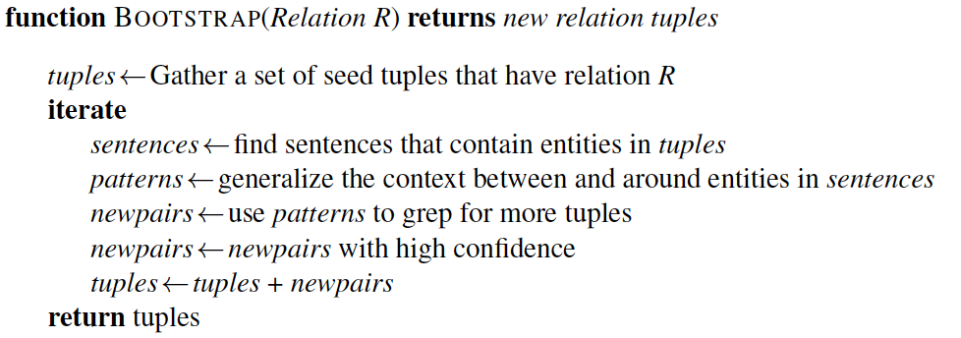
Semisupervised Relation Extraction
Bootstrapping proceeds by taking the entities in the seed pair, and then finding sentences (on the web, or whatever dataset we are using) that contain both entities.

Slide 21
Example
Task: Create airline/hub pairs
Seed: Ryanair has a hub at Charleroi
use this seed fact to discover new patterns by finding other mentions of this relation in our corpus
Sentences found:
Budget airline Ryanair, which uses Charleroi as a hub, scrapped all weekend flights out of the airport.
All flights in and out of Ryanair’s Belgian hub at Charleroi airport were grounded on Friday...
A spokesman at Charleroi, a main hub for Ryanair, estimated that 8000 passengers had already been affected.
Patterns extracted:
/ [ORG], which uses [LOC] as a hub /
/ [ORG]'s hub at [LOC] /
/ [LOC] a main hub for [ORG] /

Slide 22
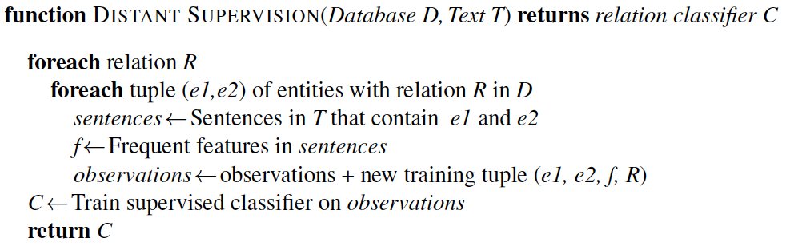
Distant Supervision
R: place of birth
(e1, e2): <Edwin Hubble, Marshfield>, <Albert Einstein,Ulm>, etc
Sentences: Hubble was born in Marshfield; Einstein, born (1879), Ulm; Hubble’s birthplace in Marshfield..., etc

Slide 23
Open IE
Unsupervised relation extraction
Find all strings of words that satisfy the tripe relation.
United has a hub in Chicago, which is the headquarters of United Continental Holdings.
r1: <United, has a hub in, Chicago>
r2: <Chicago, is the headquarters of, United Continental Holdings>

Slide 24
Evaluation of Relation Extraction
Supervised
Test sets with human annotated, gold-standard relations and computing precision, recall, and F-measure
Semi and Unsupervised
Human evaluations
Compute precision at different levels of recall

Slide 25
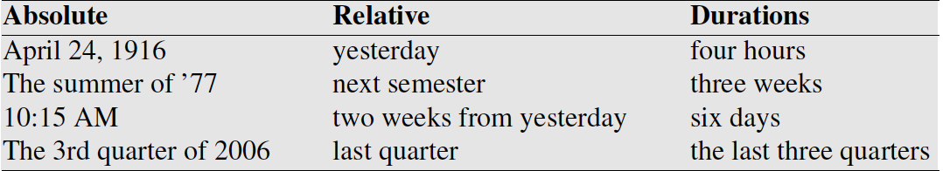
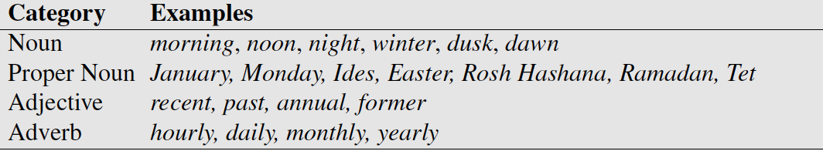
Temporal Expression Extraction
Lexical triggers for temporal expressions:
Temporal expression recognition
Temporal normalization
mapping a temporal expression to either normalization a specific point in time or to a duration

Slide 26
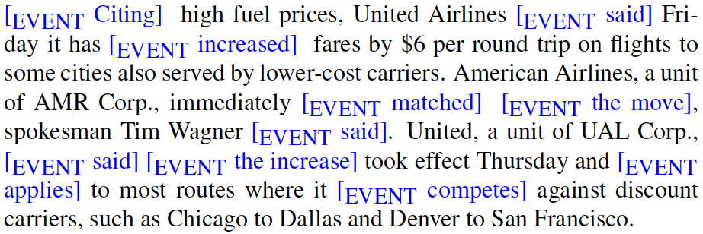
Event Extraction
In English events are typically expressed verbs like exploded, and sometimes nouns like explosion.

Slide 27
Temporal ordering of events
Delta Air Lines earnings soared 33% to a record in the fiscal first quarter, bucking the industry trend toward declining profits.
Soaringe₁ is included in the fiscal first quarter_{t58}
Soaring_{e1} is simultaneous with the bucking_{e3}
Declining_{e4} includes soaring_{e1}

Slide 28

Template Filling
Scripts are common, stereotypical situations
Templates represent scripts with a fixed set of slots that take slot-filler values
Train two separate supervised systems
Template recognition
Role-filler extraction
Most earlier systems were based on handwritten regular expressions and grammar rules.

Slide 29
The Gun Violence Database
Ellie Pavlick and Chris Callison-Burch, University of Pennsylvania

Slide 30
Goals of the GVDB
Collect data about gun violence in the US to facilitate public health research.
Draw sample from local newspapers and television stations that publish online.
Use machine learning and crowdsourcing to extract structured data from text.

Slide 31
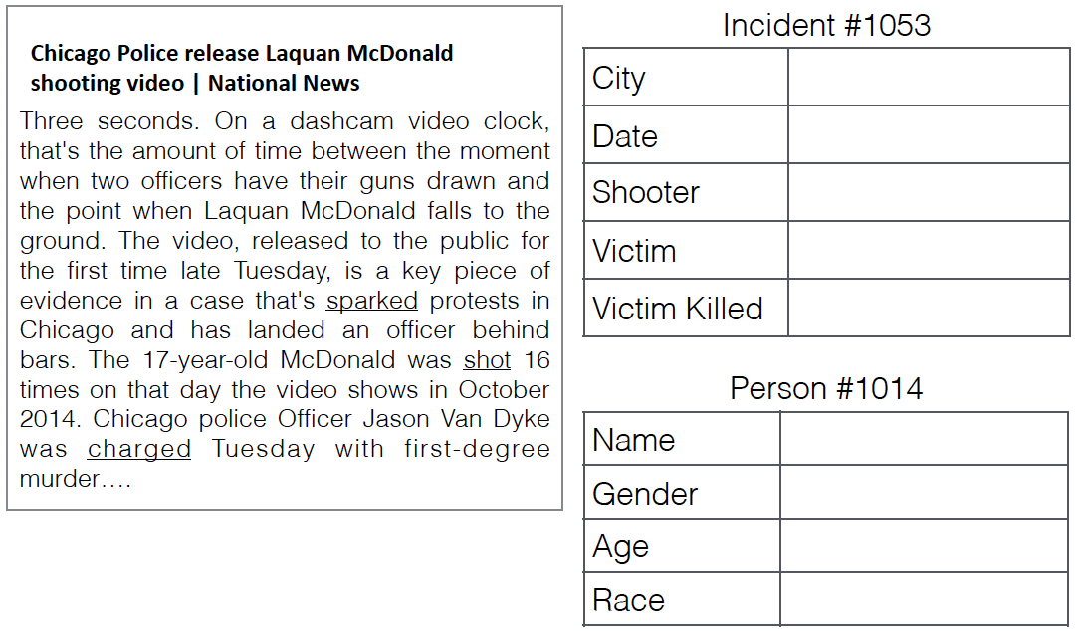
GVDB Template

